Slide 1

MYNTRA ANALYSIS
NAME: SHANDHINI
BATCH: MBE10

Slide 2
Introduction
Myntra is one of India’s largest online fashion and lifestyle retailers. Launched in 2007, it initially focused on personalized gifts but later shifted to fashion products. In 2014, Myntra was acquired by Flipkart, giving it a strong foothold in India’s booming e-commerce market.
Myntra offers a wide variety of products, including clothing, footwear, and accessories, from over 3,000 brands like Nike, Adidas, and Levis. It is known for its innovative shopping experience, with features like Myntra Insider (a loyalty program) and Myntra Studio (a content-driven fashion platform).
The company’s popular End of Reason Sale (EORS) attracts millions of shoppers every year. This analysis will explore customer sentiment, brand perception, and trends in fashion, providing insights to help Myntra improve its customer experience and market strategies.

Slide 3
SWOT ANALYSIS
Strengths
Wide Product Range
Strong Brand Presence
Technological Innovation
Backed by Flipkart
Popular Sales Events
Weaknesses
High Dependence on Sales
Logistics Issues
Limited International Presence
Opportunities
Growing Online Fashion Market
Expansion into Tier-2 and Tier-3 Cities
Sustainability Trends
Threats
Intense Competition
Price Wars
Changing Consumer Preferences
Regulatory Challenges

Slide 4



SENTIMENT ANALYSIS
20%
delivery delays
product quality
customer service
15%
Informational or generic comments that don't express a strong opinion
65%
product variety
user interface
easy returns

Slide 5
COMPETITOR ANALYSIS
.
FLIPKART FASHION
COMPETITOR LANDSCAPE ASSESSMENT
Myntra leads in product diversity but faces stiff competition from Ajio in terms of exclusive offerings.
Myntra needs to optimize its logistics further to compete with Amazon and Flipkart's delivery speed.
Myntra's pricing is competitive, especially during EORS, but the aggressive discounting by Amazon, Flipkart, and Ajio could pressure its margins
Myntra maintains a strong brand perception as a fashion-first platform, but Ajio is emerging as a significant challenger in this space.
AMAZON FASHION
MYNTRA
AJIO
LIMEROAD
TATA CLIQ

Slide 6
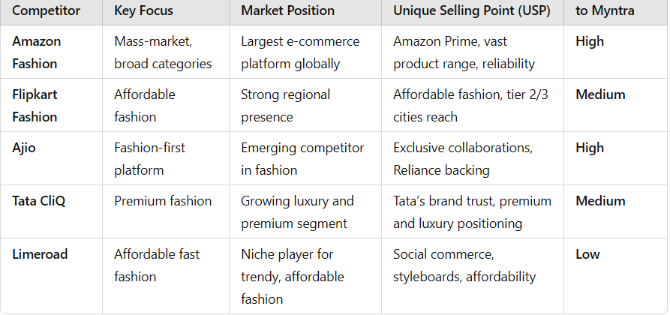
COMPETITOR FOR MYNTRA BY COMPAIRISON

Slide 7
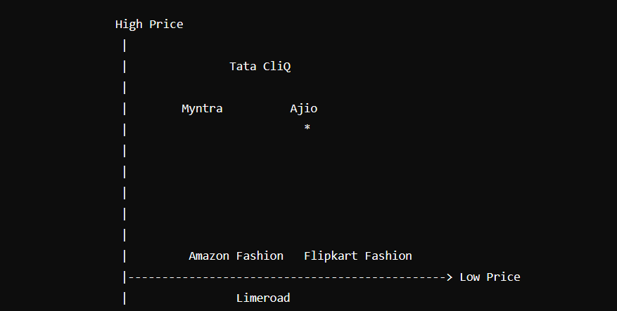
MARKET POSITION
Myntra: Positioned as a mid-range to high-end option with a wide product range.
Amazon Fashion: Positioned towards the low price end with a very wide range.
Flipkart Fashion: Similar to Amazon, positioned on the low price side but with a focus on budget-friendly options.
Ajio: Positioned as mid-range with a strong focus on fashion.
Tata CliQ: Positioned towards the high price end with a narrower product range targeting premium fashion.
Limeroad: Positioned at the low price end with a narrow focus on affordable, trendy items.

Slide 8
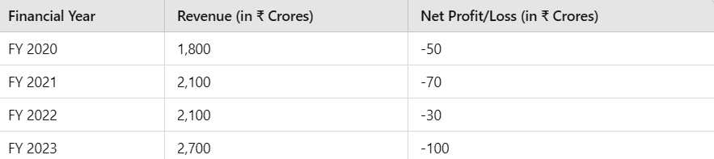
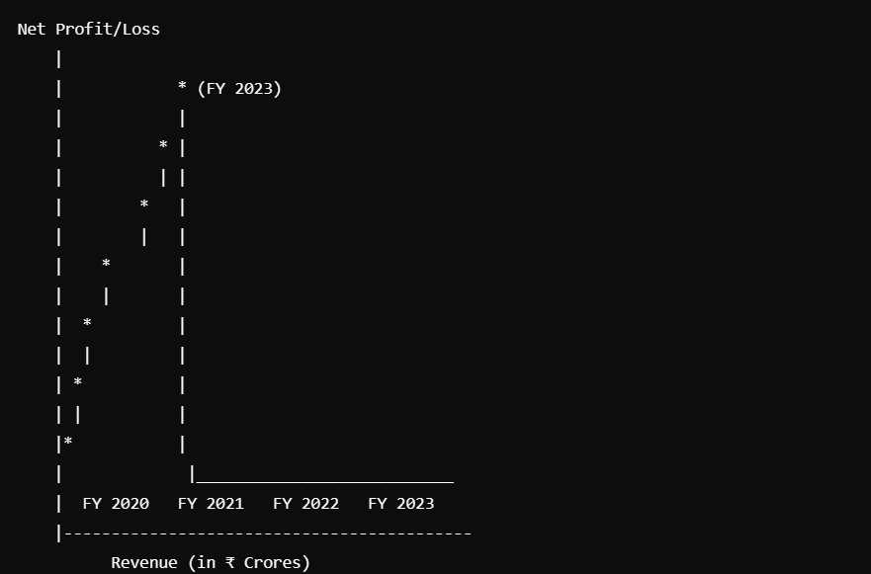
SALES AND PROFIT
Myntra saw a substantial increase in its order volume during key sales events
The platform also attracts a large number of users, with an estimated 10 million monthly active users.

Slide 9
ADVERTISEMENT OF MYNTRA
.
Platforms Used
Instagram
Facebook
Twitter
YouTube
Types of Ads
Influencer Collaborations
Carousel Ads
Story Ads
Video Ads
User-Generated Content (UGC)
Campaigns and Promotions
Seasonal Campaigns
Interactive Campaigns
Personalized Ads
TECHNICAL TAGS AND KEYWORDS
Myntra
Online Shopping
Fashion Trends Customer Engagement
Return Policy
Pricing Strategy
Sales Performance
Digital Transformation

Slide 10
DATA SET
.
Customer Data
Purchase History
Customer Demographics
Product Data
Product Catalog
Product Reviews
Sales Data
Monthly/Quarterly Sales Figures
Sales by Category
Market Data
Industry Reports
Competitor Analysis
Website Analytics Data
Website Traffic Data
App Engagement Metrics
Social Media Data
Social Media Engagement
Sentiment Analysis Data

Slide 11
HOW MYNTRA GETS POPULAR
Early Entry into E-commerce-Myntra was founded in 2007, initially focusing on personalized gifts.
Focus on Fashion-Myntra focused specifically on fashion and lifestyle products, differentiating itself from general e-commerce platforms
Extensive Brand Partnerships-Myntra partnered with local and international brands
Strong Marketing Strategies-Myntra invested significantly in marketing campaigns, leveraging traditional media (TV, print) and digital marketing (social media,
influencer partnerships) to create brand awareness.
User-Friendly Interface-Features like filters and search functionalities improved the shopping experience.
Strategic Sales Events-End of Reason Sale, promotions during festivals and special occasions
Emphasis on Customer Experience-customer-friendly return and exchange policy
Social Media Engagement-social media platforms, engaging with customers through interactive content, fashion tips, and user-generated content campaigns.
Leveraging Technology-AR features for virtual try-on
Acquisition by Flipkart-Myntra was acquired by Flipkart

Slide 12
STRATEGY AND RECOMMENDATIONS
GOALS
Increase market share in the online fashion segment
Enhance customer satisfaction and loyalty.
Expand into new markets and demographics
Recommendation
Introduce virtual stylists or chatbots to assist customers
Collaborate with fashion influencers for product promotions and exclusive collections to reach new audiences.
Create engaging content, such as fashion blogs, styling tips, and behind-the-scenes looks at new collections, to foster community and build brand loyalty.
Increase investment in private label offerings, focusing on quality, unique designs, and competitive pricing to differentiate from competitors.
Use real-time analytics to track customer behavior and market trends, enabling quick adjustments to strategies based on consumer insights.
Use real-time analytics to track customer behavior and market trends, enabling quick adjustments to strategies based on consumer insights.

Slide 13
CONCLUSION
With a clear strategy that leverages its strengths and addresses its challenges, Myntra is well-positioned to thrive in the dynamic e-commerce landscape, driving future growth and cementing its status as the go-to destination for fashion enthusiasts in India. The company's commitment to innovation and responsiveness to customer feedback further enhance its reputation.

